Slide 1
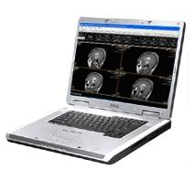
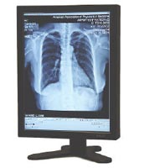
Dicom Viewer with Patient’s File in office

Slide 2
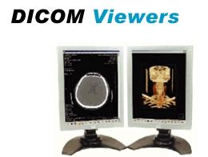
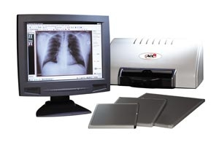
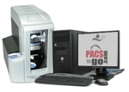
Special Thanks to:
Dr. Kahani

Slide 3
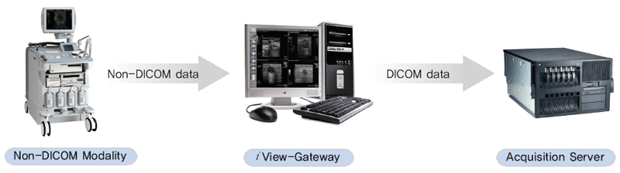
What is Dicom ?
Digital Imaging in Communications on Medicine
The Digital Imaging and Communications in Medicine (DICOM) standard is used for the exchange of images and related information. The DICOM standard can be thought of as having several levels of support, such as the support for image exchange for both senders and receivers, the underlying information model and information management services..

Slide 4
DICOM Fundamentals
Information Model
Transport
Exchanging Objects
Information Management Services
Image Quality
Security Mechanisms

Slide 5
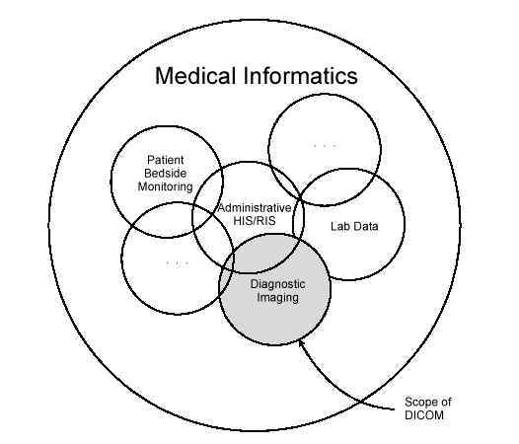
DICOM Fundamentals
Information Model
Information objects are also known as part of the Service Object Pairs (SOP) Classes. An example of a SOP Class is the CT Storage SOP Class, which allows CT images to be exchanged

Slide 6
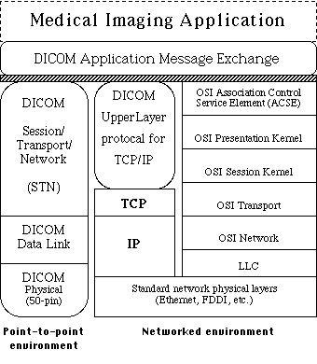
DICOM Fundamentals
Transport

Slide 7
DICOM Fundamentals
Exchanging Objects
Radiology is becoming a provider of archiving and storage services for the other specialties. This is confirmed by the ever increasing popularity of Picture Archiving and Communication Systems (PACS)

Slide 8
DICOM Fundamentals
Information Management Services
The service in this category is the DICOM Storage Commitment, which transfers the responsibility for the images to the receiver, so they can be safely removed from the local disk

Slide 9
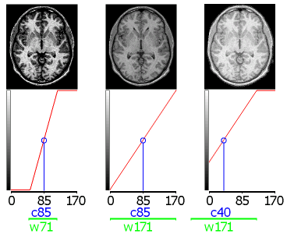
DICOM Fundamentals
Image Quality

Slide 10
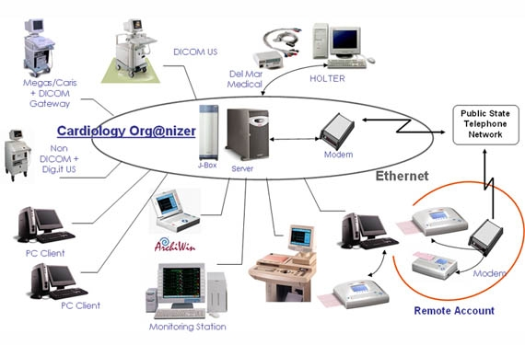
DICOM Fundamentals
Security Mechanisms

Slide 11
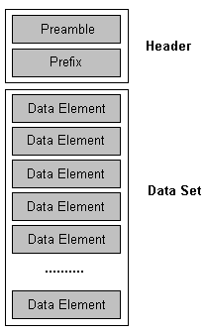
Dicom Header Format
Preamble Prefix 128 bytes = ??? ???
4 bytes = ‘D’, ‘I’, ‘C’, ‘M’

Slide 12
System Analyse & Design
UseCases
Up-Down Design
Components
Down-up Design
Class and Sequence Diagrams
Boundary Implementations
Data layer Design
Map Data layer with Back-End Database
Final Implementations and Test

Slide 13
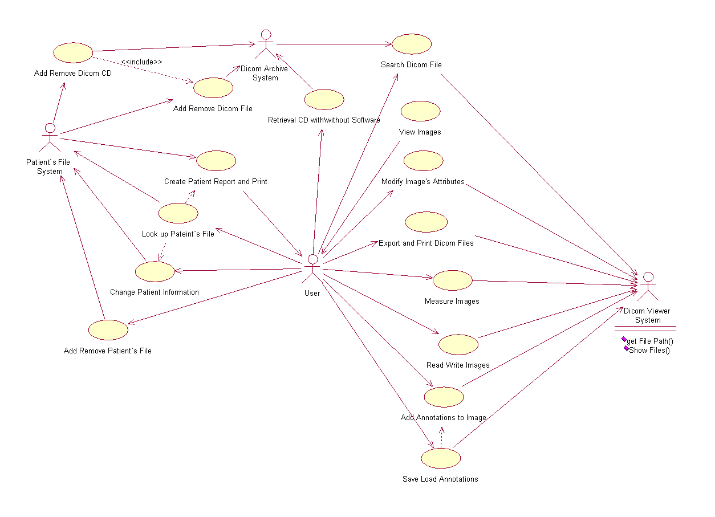
UseCases

Slide 14
Up-Down Design
System
Dicom Viewer
Package
Arcive System
Package
Patient File System
Package

Slide 15
UP-Down Design
Dicom Viewer Package
Entity
Control
Boundary
DicomImage
ImageControl
Mainviewerform
DicomAttribute
MouseControl
Tag form
DicomLabel
Lable Control
Palette
Palette Control

Slide 16
UP-Down Design
Dicom Archive
Entity
Control
Boundary
DicomCD
CDManager
CD Saved Form
DicomFile
File Management form
DicomSoftware
CD Management form

Slide 17
Up-Down Design
patient File system
Entity
Control
Boundary
Patient class
Patient workflow control
Patient Information form
Search patient form
Patient management form

Slide 18
Components
EzDicomax.ocx
DataBurner.ocx
DicomObjects.ocx

Slide 19
DicomObjects.OCX
DicomObjects
Main Objects
Collections
DicomViewer
DicomImages
DicomImage
DicomDataSets
DicomDataSet
DicomAttributes
DicomServer
DicomLabels
DicomPrint
DicomConnections
DicomAttribute
DicomContext
DicomConnection
DicomLabel

Slide 20
Down-up Design
Class and Sequence Diagrams
Boundary Implementations
        C#
        .net 2
        Mysql

Slide 21
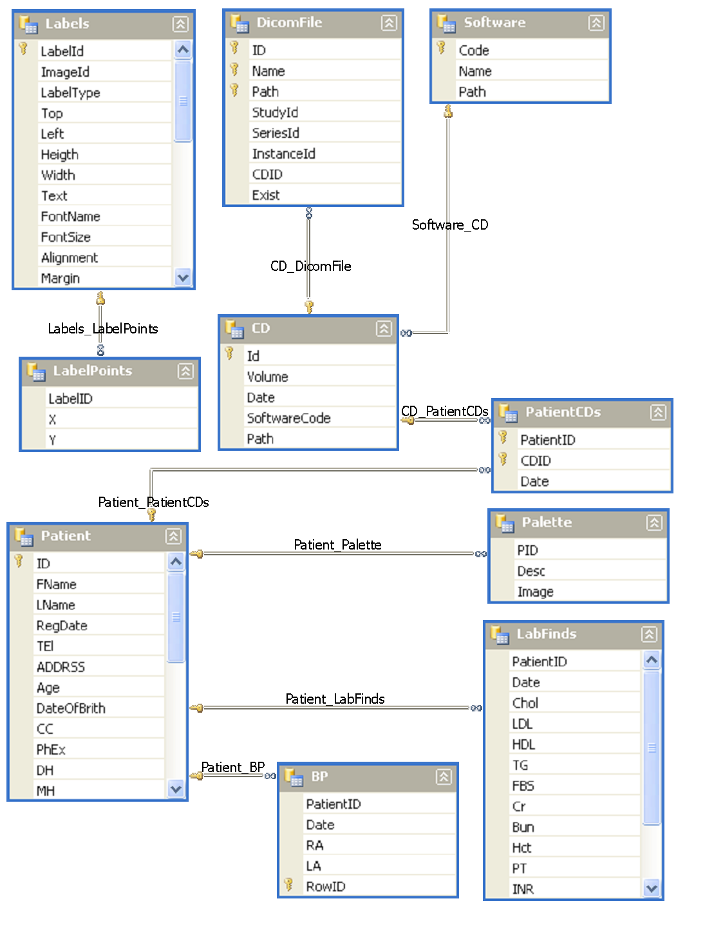
Data layer Design

Slide 22
Map Data layer with Back-End Database
Application
Front end
Back End
Select-Insert-Delete
Queries
Add
MySql
MySqlDataAdapter
Remove
QueryBuilder
Change
Memory Tabels
DataSet
Row Events
Transactions

Slide 23
Setup Script
Use mysql.exe Consol
Use MySql.Data.mySqlConnection
Open Connection
Execute Sql Scripts
Register Components

